Slide 1
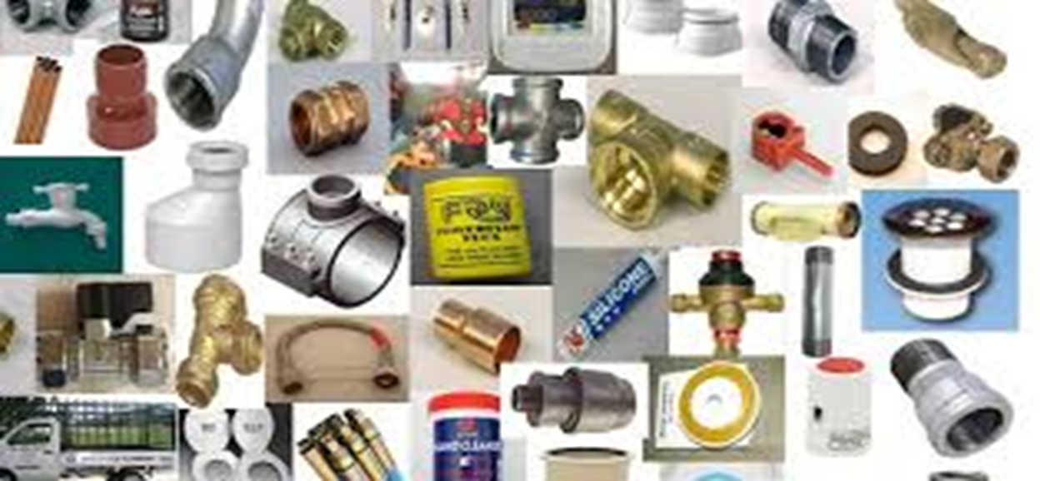
Plumbing Maintenance
Video : Introduction to Plumbing
https://youtu.be/wSDaqPPGeoA?si=DvYdj0EUh-B61ocm

Slide 2
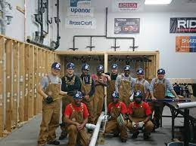
Plumbing Maintenance
Safety rules in the workshop.
1. Use protective equipments for eyes, skin and lungs
2. Don’t forget to protect your ears.
3. Watch out for electrical and fire hazards.
4. Use slip-resistant boots and mats.
5. Watch out for molds.
6. Know your chemicals.
7. Protect against burns.
8. Be careful where you tea or drink.
9. Change and seal your clothes after working with sewage.
10. Wash your hands ……A LOT.
Video:
https://youtu.be/gyWrbmQp5a0?si=TctbTAyyxtFtROHI
Feedback : Activity

Slide 3
Kwa Thema Skills School
Subject : Maintenance Marks :10
Grade : Year 1 Time : 30 mins
Date : / / 2024
Question :1 Safety rules
1. Fill in the following sentences
1.1. Use slip-resistant boots and __________.
1.2. Protect against ________________.
1.3. Know your _______________.
1.4. Be careful where you eat or ______________.
1.5. Watch out for electrical and fire __________.
1.6. Change and seal your clothes after working with ____________.
1.7. Wash your _________ … A LOT.
1.8. Don’t forget to protect your __________.
1.9. Watch out for _____________.
1.10. Use protective equipments for eyes, skin and ____________.

